Slide 1
Employee Emergency Timer
Milestone #1 by: Riley Barringer

Slide 2
Structure
Background
How it Works
Demonstration of Android Application
Demonstration of Networking Portion
Conclusion

Slide 3
Background
Target Audience- Delivery drivers
Delivery driving can be a very dangerous job
Last January, there were reports of 8 robberies of delivery drivers in Newport News
Delivery driver in Ohio had their vehicle stolen last July
Not allowed to carry a weapon
Need a passive form of security
Personal Experience
Once stuck in hotel room, texted friends my location

Slide 4
What It Does
User sets who they want their location to go to, as well as their cell phone number
User sets timer to how long they think a delivery would take
If user makes it back to the vehicle in timely manner, they stop the timer and reset it before it goes off
If user is too late/ does not return, the app sends their phone number and location to their contact of choice (i.e. employer) who will then check up on them/ call the police if no answer
Provides sense of security to employee

Slide 5
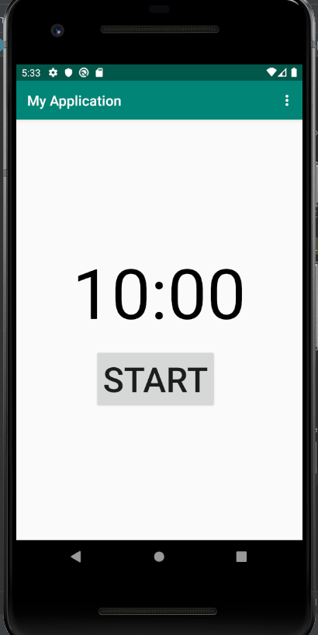
Layout is deliberately simple and easy-to-navigate- any functionality that needs to be changed is hidden within the toolbar.
Menu Bar
Timer
(Obviously) Button to start timer

Slide 6
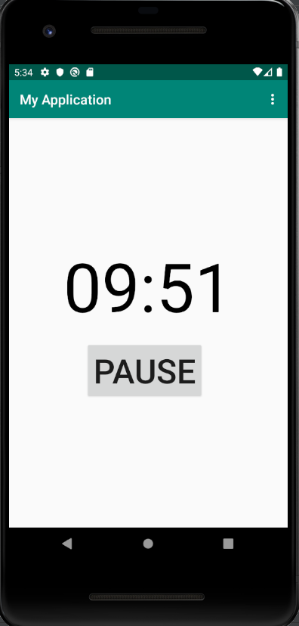
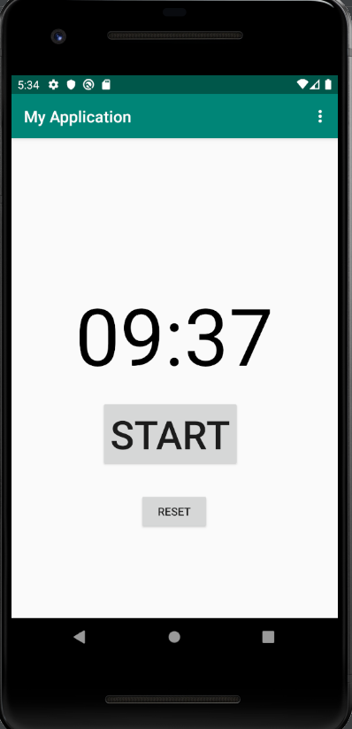
When the timer is paused, the user has the ability to continue the time or reset it.
Once pressed, the Start Button becomes a Pause Button- having only one button on the screen at a time reinforces usability.

Slide 7
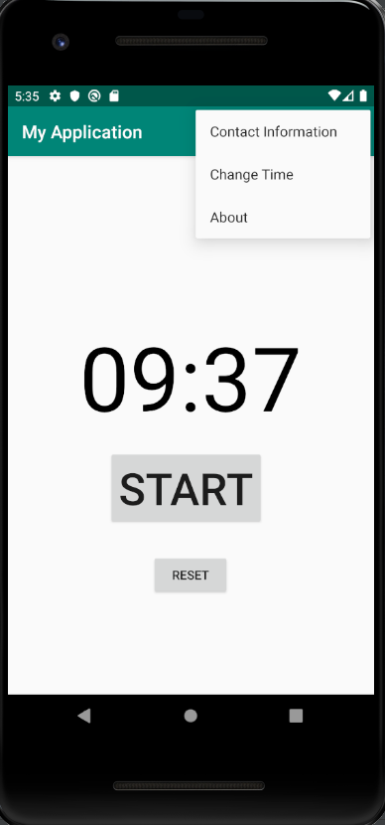
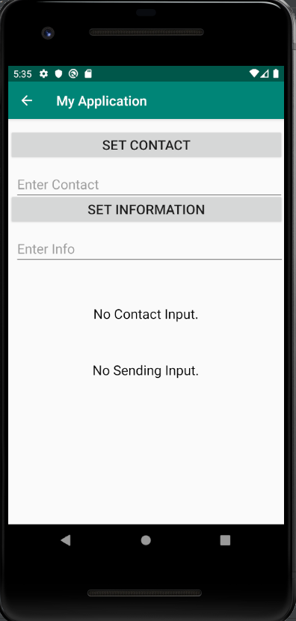
Here, the user has the ability to set where they would like their information to go, as well as any additional information they would like to send the receiver.

Slide 8
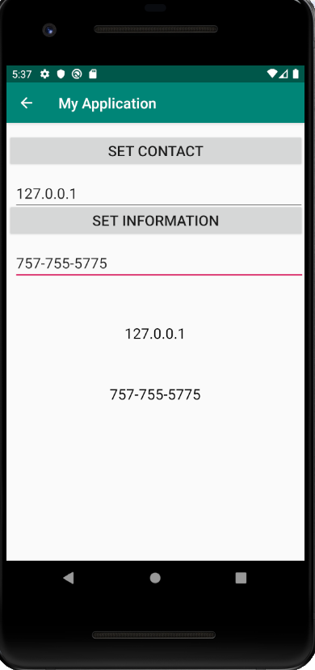
My current solution for setting a contact is manually setting the IP address of the server to the client
My intentions with the “Set Information” section is having the user send their phone number to the server; however, it may be possible to take the phone number directly from the device- more research is needed

Slide 9
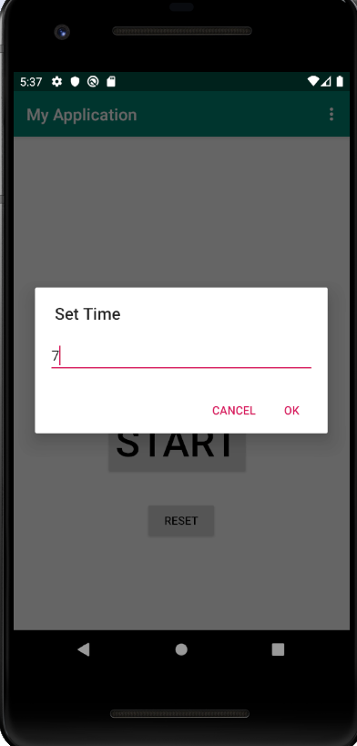
Tapping on the “Change Time” setting brings up a pop-up box in which the user can set the time
Up to a 4 digit number
Algorithm adds extra digits to timer if hours need to be included

Slide 10
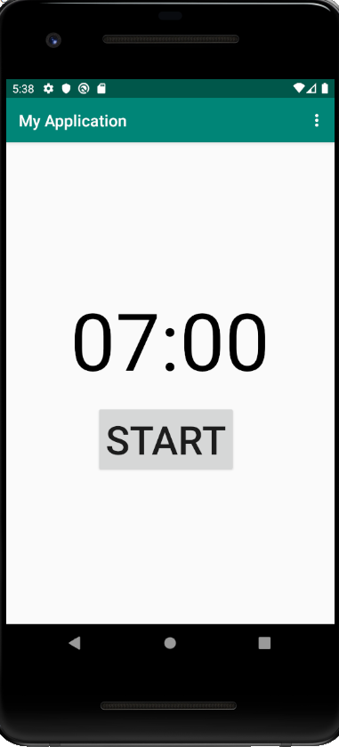
Numbers go by minutes
Seconds not yet settable, will work out bug in near future
Timer will now default to this value when Reset is hit

Slide 11
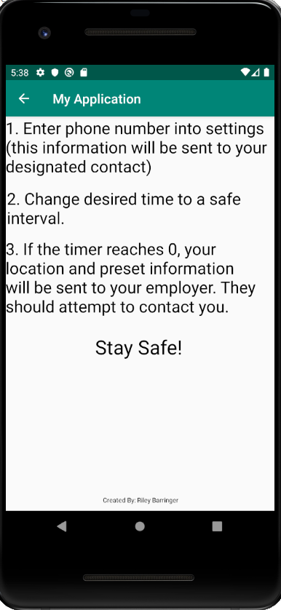
About page simply displays how to use the app and other information the user may need.

Slide 12
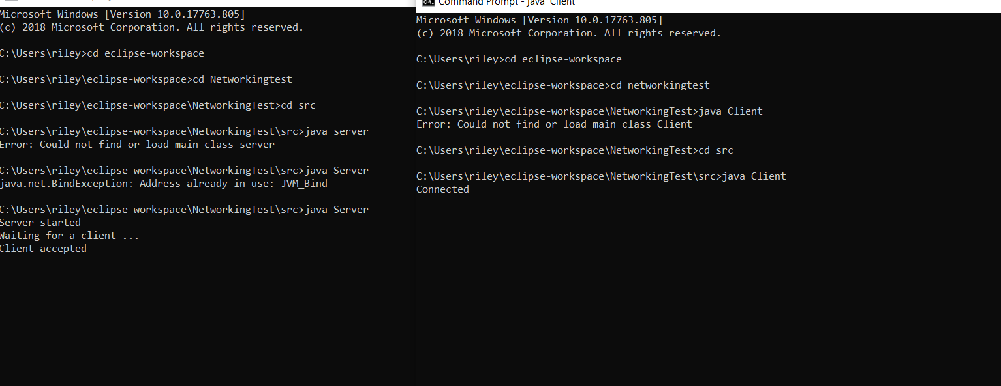
Networking Test

Slide 13
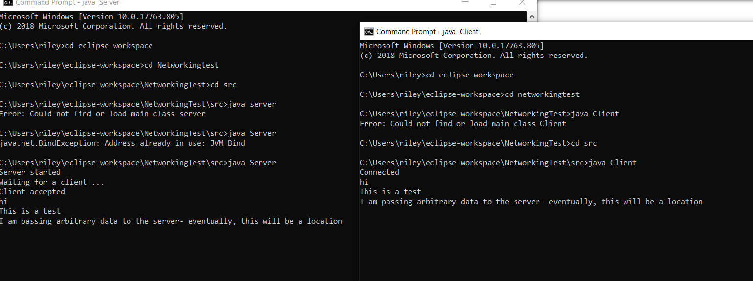
Networking Test

Slide 14
Conclusion
By next milestone, I will hopefully…
Work on attractiveness of product
Fix any minor bugs (i.e. not being able to set how many seconds)
Integrate Google Maps into my project
Be able to send the coordinates of the device to another machine

